Slide 1

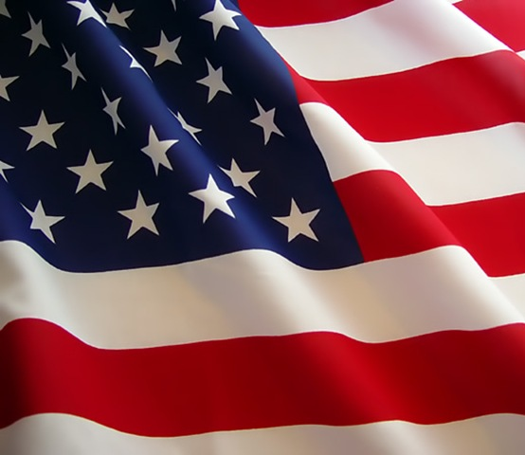

The Revolutionary War Veteran’s Association presents
The Appleseed Project
Le Roy Rifle and Pistol Club
Le Roy, Illinois
October 27-28, 2012
The Appleseed Project is a nationwide program that teaches rifle marksmanship and American heritage. We seek to rekindle our shooting skills through the lost fundamentals of position, breathing, trigger control and natural point of aim. We also reconnect Americans lost sense of heritage through the story of April 19, 1775, telling of our forefather’s difficult choices, heroic actions, and sacrifices they made for their posterity.
What You Will Learn?
History of the Lexington and Concord
Role of the American Rifleman
Shooting With a Sling
Proper Shooting Positions
Six Steps To Firing A Shot
Natural Point of Aim
Rifleman’s Cadence
Known Distance Shooting
Safety, Sight Adjustment, Trigger Control, and Much More
Learn more and sign up at www.appleseedusa.org
The Appleseed Project is a 501(c)(3) non-profit organization and will host over 1000 shoots nationwide this year, 40 in Illinois. Over 100,000 participants have gone through the program since 2006. We have over 1000 volunteer instructors who each put in 120+ hours of hands-on experience and evaluation prior to becoming certified as an instructor.
Le Roy, IL Appleseed
October 27-28, 2012
appleseedusa.org
Le Roy, IL Appleseed
October 27-28, 2012
appleseedusa.org
Le Roy, IL Appleseed
October 27-28, 2012
appleseedusa.org
Le Roy, IL Appleseed
October 27-28, 2012
appleseedusa.org
Le Roy, IL Appleseed
October 27-28, 2012
appleseedusa.org
Le Roy, IL Appleseed
October 27-28, 2012
appleseedusa.org
Le Roy, IL Appleseed
October 27-28, 2012
appleseedusa.org
Le Roy, IL Appleseed
October 27-28, 2012
appleseedusa.org
Le Roy, IL Appleseed
October 27-28, 2012
appleseedusa.org
Le Roy, IL Appleseed
October 27-28, 2012
appleseedusa.org
Le Roy, IL Appleseed
October 27-28, 2012
appleseedusa.org
Le Roy, IL Appleseed
October 27-28, 2012
appleseedusa.org

