Slide 1
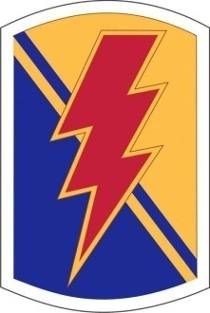
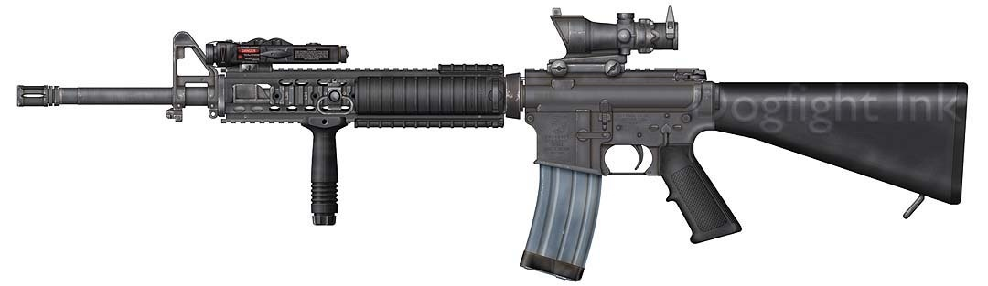
Marksmanship Fundamentals
SPC Lars Reichenbach
Security Level: Unclassified

Slide 2
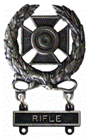
References
FM 3-22.9 | Rifle Marksmanship M16A1, M16A2/3, M16A4, and M4 Carbine | 24 Apr 2003
 | National Guard Marksmanship Training Center Squad Designated Marksman Data Book | Mar 2009
TM 9-1005-319-10 | Operator's Manual for Rifle, 5.56-mm, M16A2; Rifle 5.56-mm, M16A3; Rifle, 5.56-mm, M16A4; Carbine, 5.56-mm, M4; Carbine, 5.56-mm, M4A1 | 01 Oct 1998

Slide 3
Terminal Learning Objectives
Task: | Utilize Marksmanship Fundamentals while employing your assigned individual weapons system (M16A4/M4)
Conditions: | Given an M16A4 rifle/M4 Carbine assume proper body position, sight alignment/picture, breathing control and trigger squeeze
Standards: | Given your assigned individual weapons system (M16A4/M4) demonstrate an understanding of the four marksmanship fundamentals by explaining and employing them successfully

Slide 4
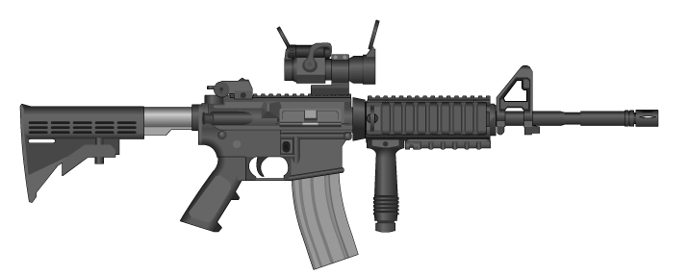
M4 MWS Carbine Capabilities
Caliber…………………………….. 5.56mm (M855 ball, M856 Tracer)
Weight……............................ approx 9 lbs (w/ 30 rd Magazine, M68 CCO, AN/PEQ-15)
Length……………………………… Butt stock Closed 29.75 in
Butt stock Open 33.0 in
Mechanical Features:
Rifling…………………………….. 14.5” barrel (RH 1/7 twist)
Detachable carrying handle w/ integral accessory mounting rail
Butt stock has four positions; closed, ½ open, ¾ open, and fully open.
Firing Characteristics:
Muzzle Velocity……………… 2,970 fps
Chamber Pressure…………. 52,000 PSI
Cyclic Rate of Fire…………… 700 - 970 RPM (approx)
Fire Selector…………………… SAFE – SEMI – BURST
Max Effective Rate of Fire:
Semi……………………………… 45 rpm
Burst…………………………….. 90 rpm
Sustained Rate of Fire……. 12/15 rpm
Max Effective Range…………. 550 meters (individual/point targets)
600 meters (area targets)
Max Range………………………… 3600 meters

Slide 5
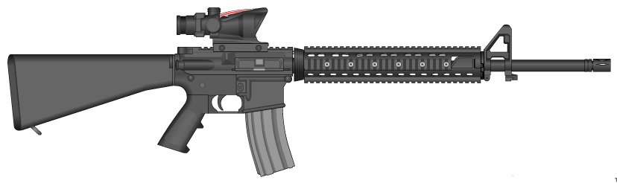
M16A4 MWS Rifle Capabilities
Caliber…………………………….. 5.56mm (M855 ball, M856 Tracer)
Weight……............................ approx 10.5 lbs (w/ 30 rd Magazine, M68 CCO or AN/PVQ-31 ACOG, AN/PEQ-15)
Length……………………………… 39-5/8th in
Mechanical Features:
Rifling…………………………….. 20” barrel (RH 1/7 twist)
Detachable carrying handle w/ integral accessory mounting rail
Firing Characteristics:
Muzzle Velocity……………… 3100 fps
Chamber Pressure…………. 52,000 PSI
Cyclic Rate of Fire…………… 800 RPM (approx)
Fire Selector…………………… SAFE – SEMI – BURST
Max Effective Rate of Fire:
Semi……………………………… 45 rpm
Burst…………………………….. 90 rpm
Sustained Rate of Fire……. 12/15 rpm
Max Effective Range…………. 550 meters (individual/point targets)
600 meters (area targets)
Max Range………………………… 3600 meters
Notes:
The M16A4’s max effective range is 600m due to the limitations of the detachable carry handle sight; with ACOG the max effective range is 800m

Slide 6

Marksmanship Fundamentals
Four basic Marksmanship Fundamentals form building blocks to allow a soldier to engage and successfully hit a target; Soldiers must have these basic fundamentals engrained to muscle memory as they serve as the basis for all marksmanship skills
Marksmanship Fundamentals include (in order) Steady Body Position; Proper Sight Alignment/Picture; Proper Breathing Control; and Proper Trigger Control
Most soldiers have been taught the Marksmanship Fundamentals; however even more have been taught them incorrectly. Many lessons taught at Basic Combat Training or passed down during unit-level training are based on improper technique or “old-wives tales”

Slide 7
Steady Body Position
A steady and proper body position allows the shooter to maintain a stable platform from which the bullet can exit from – the steadier the body position, the more likely the shooter’s round will go exactly where it is intended. A steady body position and good natural point of aim will also allow for quicker follow up shots; if the shooter is positioned correctly, his rifle should return to the same point of aim after each shot.
Several factors play into steady body position – placement of the non-firing hand, placement of the firing hand, placement of the butt stock in the pocket of the shoulder, proper stock weld, proper elbow/magazine support of the weapon, and achieving a natural point of aim.
The shooter must be able to assume the same body position from muscle memory to strike the intended point of impact each time – CONSISTENCY IS ACCURACY!

Slide 8
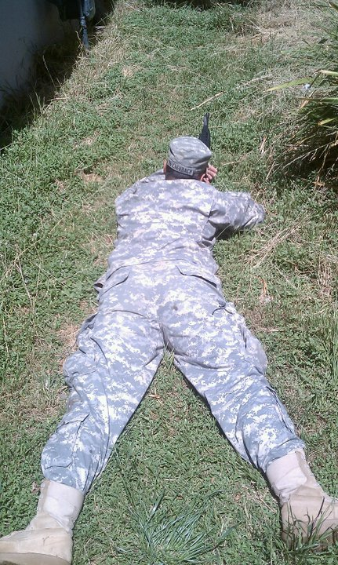
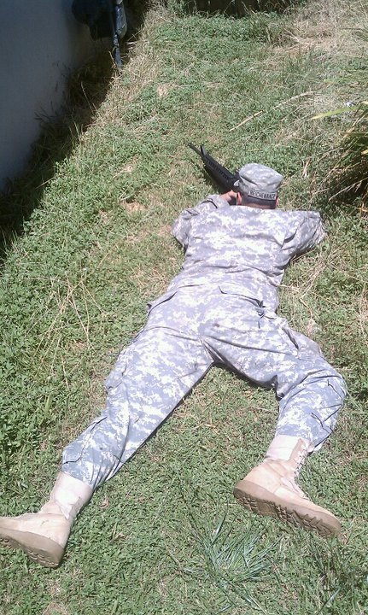
Prone Position – Body Alignment
Correct Body Position
Incorrect Body Position
When assuming a proper prone position, soldiers must make sure their body is in-line behind the weapon; not only does it limit their profile, it allows the body to absorb the recoil from each shot. Elbows will provide stable bone support on the ground and feet will be kept flat to the ground; if the elbows are kept close in and toes are to the ground instead of the whole foot, the position will not be stable.

Slide 9
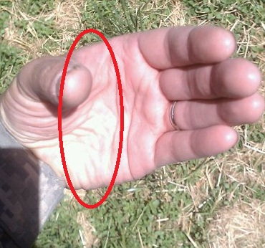
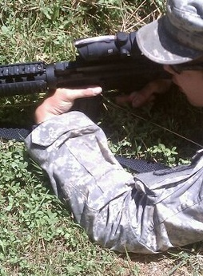
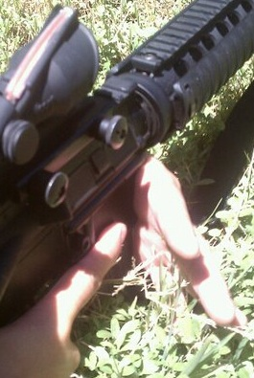
Prone Position – Non-Firing Hand
The non-firing hand will form a V shape around the magazine well, pulling the weapon with the meaty portion of the hand between thumb and fingers into the shoulder pocket. Do not use your fingers to pull, as this will cause you to pull your shots. You should be able to freely wiggle your fingers – no white knuckles.

Slide 10
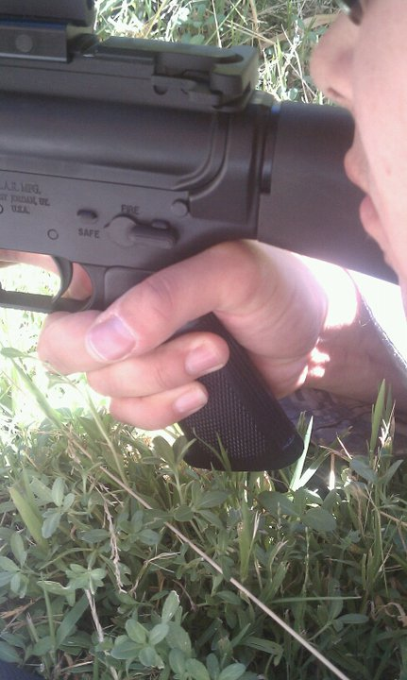
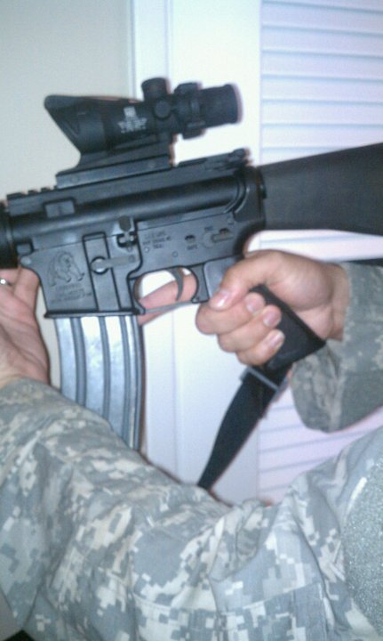
Prone Position – Firing Hand
GO: The firing hand grip is high up on the pistol grip, and is being firmly pulled straight back by the V where the fingers and palm meet, helping lock the butt stock in to the shoulder pocket. Like the non-firing hand, the fingers can be freely wiggled.
NO-GO: The firing hand grip is low on the pistol grip. The fingers are gripping the pistol grip tightly, potentially pulling the round from the intended point of impact.

Slide 11
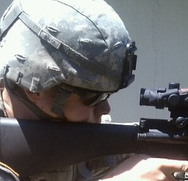
Prone Position - Stock Weld
Stock Weld is the shooter’s cheek being locked tightly against the butt stock of the rifle, rather then just rested on it. Good stock weld, along with each hand pulling the rifle tight in to the shoulder pocket, will facilitate that the weapon and the shooter’s head will move in unison with the recoil of each shot - allowing for more rapid sight picture recovery and follow up shots. Consistent stock weld is also crucial in keeping the same eye relief when obtaining correct sight picture.

Slide 12
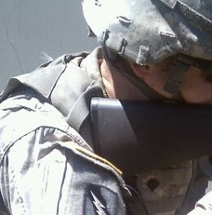
Prone Position – Shoulder Pocket
The meaty area between the shooter’s shoulder and collarbone forms the shoulder pocket. The rifle must be kept tightly in the shoulder pocket to lessen the effects of recoil and keep the butt stock from slipping while firing. The weapon is kept locked in the shoulder pocket from a combination of pull from the firing and non-firing hands as well as proper spot weld.

Slide 13
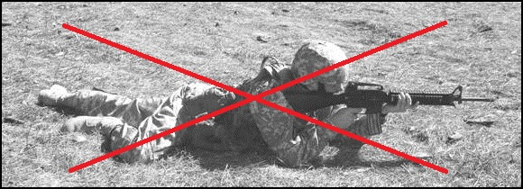
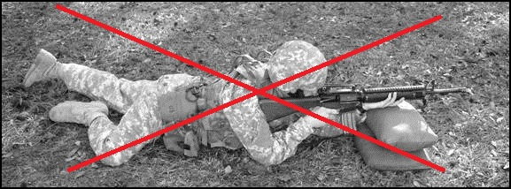
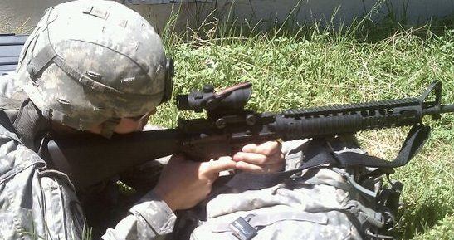
Prone Position – Barrel Support
Do not use sandbags or your non-firing hand to support the weight of the barrel; this will affect the weapon’s barrel whip and throw your rounds off target unless you use sandbags or the exact same force from your non-firing hand for EVERY SHOT – an impossibility considering we have to shoot from unsupported prone and kneeling positions.
Use the magazine to support your barrel.
The magazine well is the M16/M4’s center
of balance, and contrary to popular thought,
resting the weight of the weapon on the
magazine will not cause a malfunction. If you are
wearing your full-battle rattle and it
is hard to rest the magazine on the ground,
place it on something higher such as your
assault pack or a berm.

Slide 14
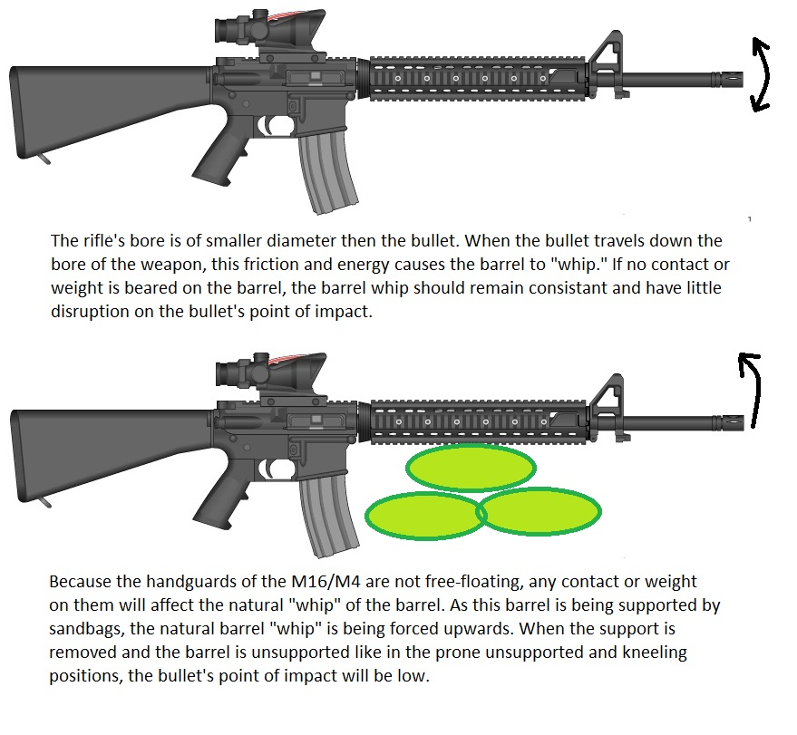
Barrel Whip

Slide 15
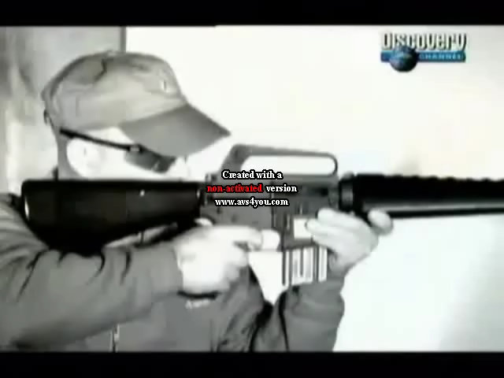
Barrel Whip - Video

Slide 16
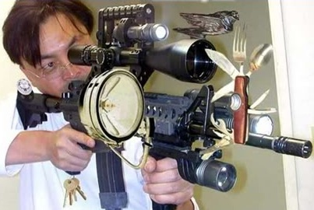
Barrel Whip - Accessories
Does barrel whip mean that any accessories you have on your rifle like weapon lights, laser aiming devices, vertical fore-grips, etc. will effect your point of impact?

Slide 17
Barrel Whip - Accessories
Does barrel whip mean that any accessories you have on your rifle like weapon lights, laser aiming devices, vertical fore-grips, etc. will effect your point of impact?
YES!
Any weight forward of the hand guard slip ring will effect the bullets trajectory – however, if the weapon accessory is kept mounted in the same spot as when you zeroed your weapon, your point of impact should remain consistent. If you move an accessory you will change the balance of weight on the barrel and you will have to re-zero the weapon.

Slide 18
Natural Point of Aim
Natural point of aim is where your body position is aiming your weapon - using minimal muscle movement to keep the body position and sights aligned with the target – instead of using muscles to keep the sight on the target, a shooter who has natural point of aim is relaxed and lets their body position take care of it, reducing muscle strain and keeping consistency; if the shooter uses their muscles to aim, not only will they cause muscle strain and fatigue, they must also use the exact same muscle force each time or their shot placement will be inconsistent. Remember: CONSISTENCY IS ACCURACY.
To check and see if you have achieved Natural Point of Aim, assume a good sight picture then close your eyes. Take three deep breathes and open your eyes. If your sight picture has drifted off of the target, readjust your body position and try again.
Natural point of aim is used mostly in the prone or kneeling positions where it is possible to provide the weapon with bone support. As the offhand/standing position provides little to no bone support, it is necessary to use the muscles to keep sights on target.

Slide 19
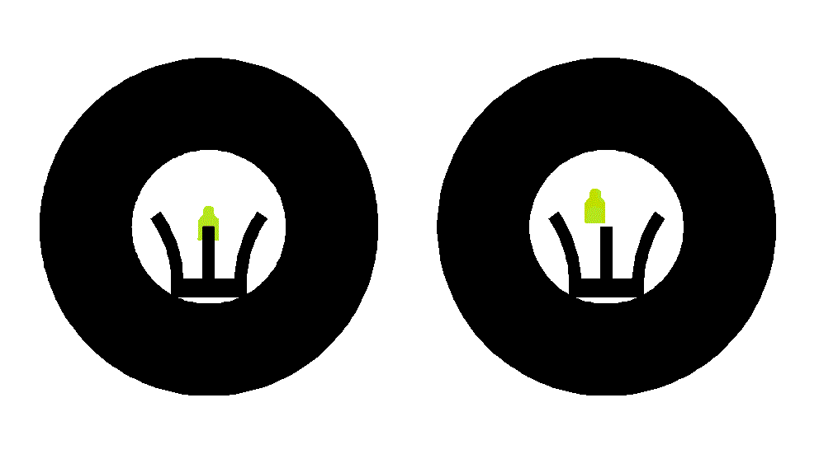
Natural Point of Aim
If you close your eyes and take three deep breaths and your sights are no longer on target when you open your eyes you do not have natural point of aim - You are using your muscles rather then your body position to keep your weapon on target. Readjust your body position towards the target and check again.

Slide 20
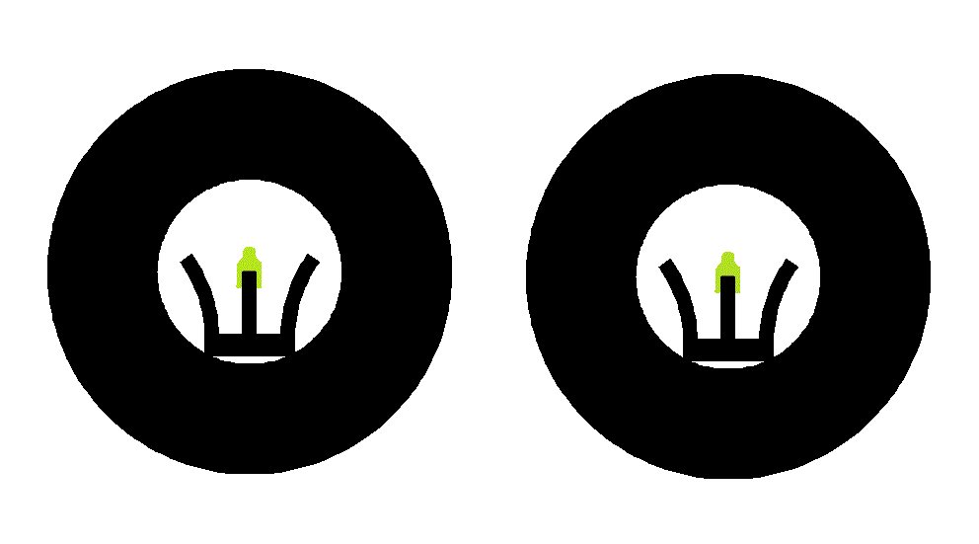
Natural Point of Aim
If you close your eyes and take three deep breaths and your sights remain on the target when you open your eyes your body position is correct and you have natural point of aim towards the target.

Slide 21
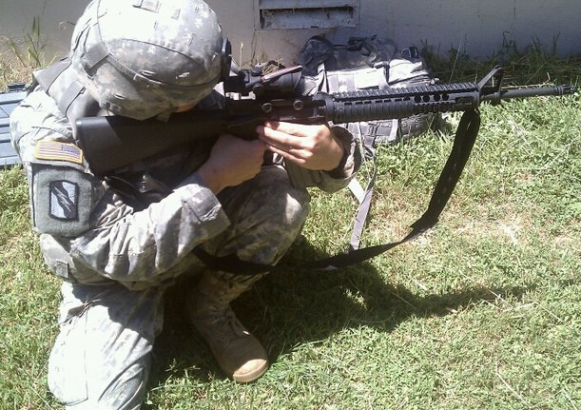
Kneeling Position
The shooter will place his body at approximately a 90 degree angle from the target. The firing knee will take a stable position on the ground with the non-firing knee forming a stable support for the non-firing elbow.

Slide 22
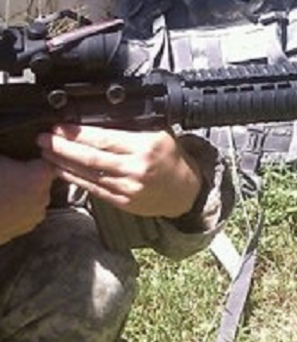
Kneeling Position
The shooter’s non-firing hand will create a V shape high on the pistol grip and will pull straight back in to the shoulder pocket; the non-firing elbow and forearm will rest comfortably on the non-firing thigh.
To provide barrel support, the shooter will either rest the magazine on top of the non-firing knee, or will place the knee between the gap created by the pistol grip and magazine.

Slide 23
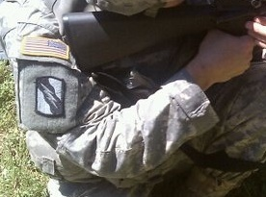
Kneeling Position
The shooter’s firing hand will be placed high on the pistol grip, with pulling force directly to the rear to the shoulder pocket. The firing elbow will rest relaxed against the body to promote stability and prevent muscle fatigue and wobble.

Slide 24
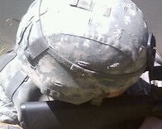
Kneeling Position
The shooter locks their cheek over the butt stock to get behind the sights and creates positive stock weld by keeping cheek securely to the butt stock. The butt stock is pulled tightly in to the shoulder pocket by both the firing and non-firing hands and locked in place with the stock weld.

Slide 25
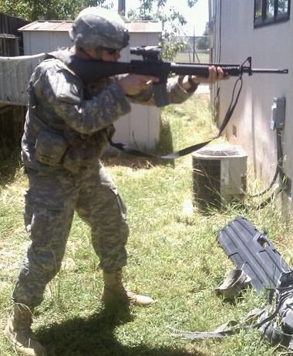
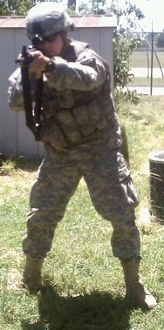
Standing Position
The soldier assumes a “fighting stance” with feet about shoulder width apart and knees slightly bent. The shooter’s body is postured aggressively forward and ballistic plates are kept squared up with his target to provide maximum protection.
The firing hand is held high on the pistol grip with straight rearward pull. The non-firing arm is kept locked out as far as possible on the hand guard with rearward pull with the thumb being pointed towards the enemy. Although force is being applied forward of the hand guard slip ring, the far forward grip will help control the weapon while transitioning from different targets. As the standing position is generally used only for close ranges, the effect on the point of impact from placing force on the barrel is negligible.

Slide 26
Sight Alignment/Sight Picture
A shooter must be able to properly aim at a target to hit it. Proper aim consists of the shooter having proper sight alignment of his rear and front sights, and a proper sight picture on the target.
Sight alignment is the most crucial factor in aiming; because misaligned sights is an angular error, the smallest of errors are magnified exponentially downrange – for each ½ meter the bullet travels, the effect of a misaligned sight doubles. This means that at 25-meters, any error in rifle alignment is multiplied 50 times. If there is an error in sight alignment, it can cause the target at 300 meters to be missed by several feet.
Once the shooter has properly aligned his sights, a sight picture can be obtained by placing the front sight post – or if an optic is used, the reticle - over the target and take the shot.

Slide 27
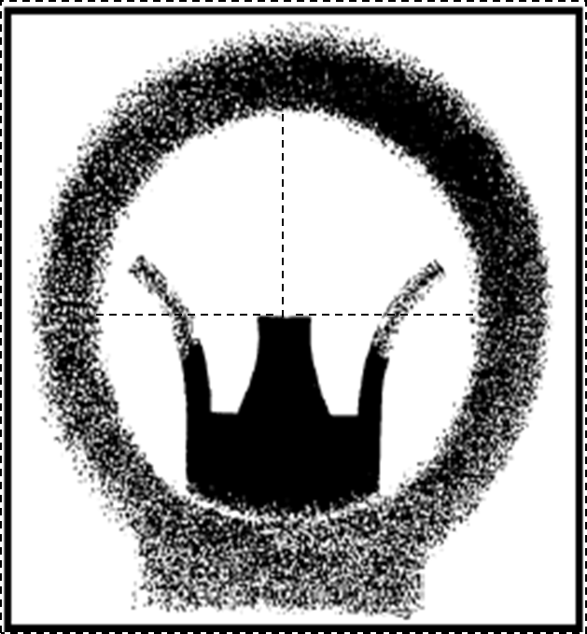
Sight Alignment
The front sight post must be centered in the rear sight aperture as if forming the bottom line of a crosshair with the tip of the front sight post being the very center of the crosshair.
As our eyes can only focus on one object, the shooter must focus on the front sight post to obtain proper sight alignment in the center of the rear aperture.
When the eye is focused on the front sight post, the natural ability of the eye to center objects in a circle and to seek the point of greatest light (center of the aperture) aid in positioning the front sight post in the center of the rear sight, providing correct sight alignment.

Slide 28
Sight Alignment
Are all of these sights aligned?

Slide 29
Sight Alignment
Yes! Even though the pictures appear differently, all of the front sight posts are aligned in the center.
Notes:
Even though each of these sight pictures look different due to eye relief, they are all aligned properly.

Slide 30
Sight Alignment
Are all of these sights aligned?

Slide 31
Sight Alignment
No! The front sight post is centered in only the top right aperture.

Slide 32
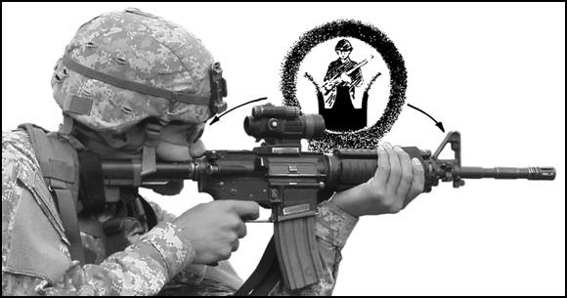
Sight Alignment – Eye Relief
The distance between the shooters eye and the rear sight is known as eye relief. With iron sights, there are four factors involved in obtaining a proper sight picture; the shooter’s eye, the rear sight aperture, the front sight post, and the target. As the distance between the rear and front sights does not change and the shooter has no control over the target, consistent eye relief is paramount to achieving proper sight alignment every time.
Having the eye too close to the rear sight may make aligning the sights difficult as the open area of the rear sight aperture is large. Alternately, it is also difficult to obtain sight alignment if the eye is too far from the aperture. The shooter must find a comfortable medium and keep eye relief consistent.
Certain optics - such as the ACOG - have a fixed eye relief that the shooter must maintain to obtain a proper sight picture and avoid scope shadow.

Slide 33
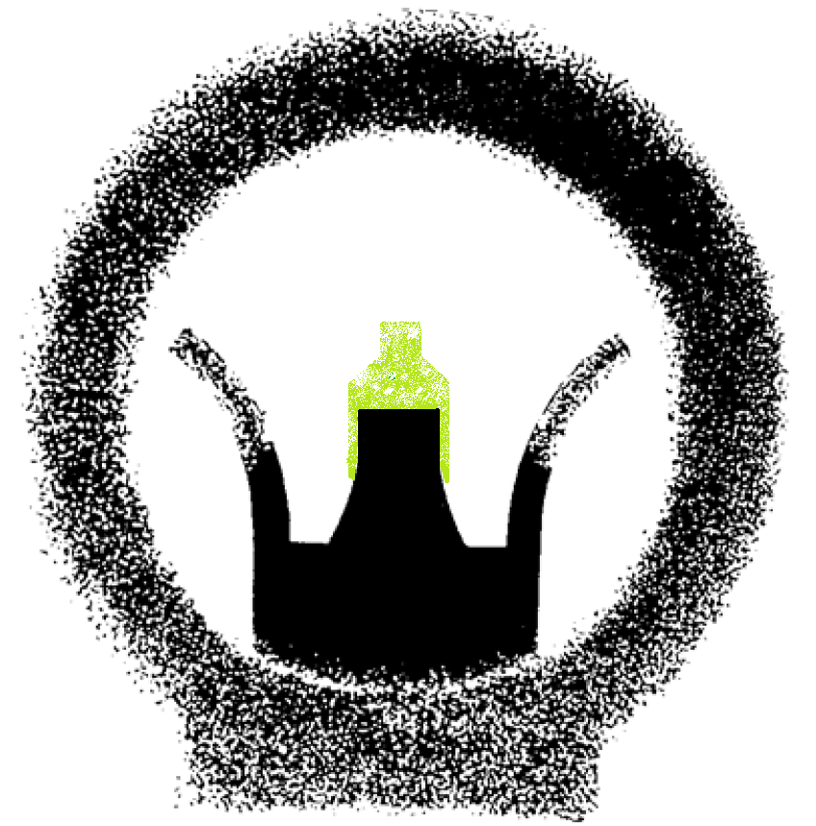
Sight Picture – Iron Sights
When obtaining a sight picture the shooter must continue to focus on the front sight post – once the front sight post is squared center mass over the target, the shooter must not break focus on it.
The shooter must accept a small wobble area and continue to concentrate on the front sight post. Breaking concentration to re-align the sights or focus on the target will change the point aim, and ultimately the point of impact - resulting in a vertical break in the shot group.
If the shooter concentrates on the front sight post for too long, they may suffer from eye strain. The shooter should not try for the proverbial “perfect shot” picture - if the front sight is over the target when the trigger is squeezed, the round will hit.
“STUDY LONG, STUDY WRONG!”

Slide 34
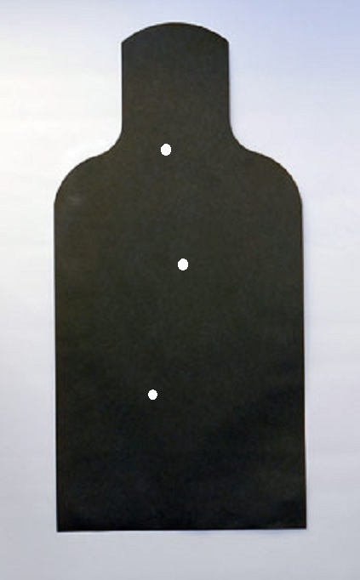
Sight Picture – Iron Sights
What would cause a shot group to open up like this?

Slide 35
Sight Picture – Iron Sights
What would cause a shot group to open up like this?
Large vertical shot groups are frequently blamed as poor breathing control being at fault – the real culprit is the shooter breaking concentration of the front sight post. Focusing between the front sight post and target will change your point of aim and open up your shot group vertically.

Slide 36
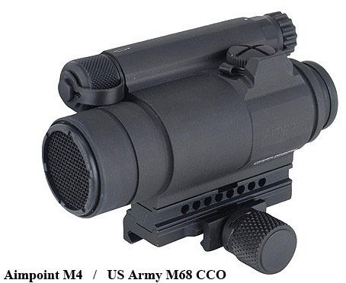
Sight Picture – M68 CCO
When a soldier uses the M68 Close Combat Optic, there are slight changes to aiming fundamentals. If the target is within 50 meters, the red dot still must be aligned in the center of the optic. However, because the M68 is considered parallax free beyond 50 meters, the red dot will be the point of aim for targets further then 50 meters - regardless of if the red dot is centered in the optic or not.
The M68 CCO also has unlimited eye relief, allowing the shooter to be able to obtain stock weld on any position on the butt stock after the weapon is zeroed with minimal change on point of impact.
Keeping both eyes open while using the M68 CCO is the preferred method of aiming as it allows for greater peripheral vision, though an operator may choose to close the non-firing eye with no effect on point of impact.

Slide 37
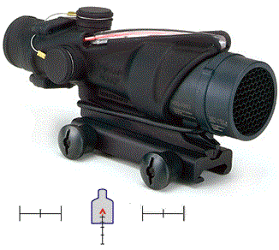
Sight Picture – ACOG
The ACOG is a 4x magnified optic, allowing a soldier to engage targets more precisely at longer ranges. Unlike the M68 CCO, the ACOG is not parallax free and the shooter needs to keep similar aiming principals to if they were using iron sights.
The ACOG has an 1.5” eye relief – If the shooter is positioned too far from the optic they will not obtain a proper sight picture; too close and they will suffer from scope shadow obscuring sight picture.
Like when using the iron sights, the shooter should focus on the reticule of the ACOG rather then the target. This can be difficult as the magnification allows the shooter a clearer picture of the target, but the shooter must maintain concentration on the reticule to ensure the round strikes where it is intended.
The ACOG reticule features several labeled aiming points for different ranges - however, there is an ACOG model calibrated specifically for each the M16A4 (AN/PVQ-31A) and the M4 (AN/PVQ-31B); if the model calibrated for the M4 is used on the M16A4 or vice versa, the various aiming points on the stadia lines will not be applicable, and the shooter will have to gather data for different ranges to discern which aiming point they should use for each range.
Notes:
If the ACOG issued is not for the rifle the shooter has, the shooter will have to gather data for different ranges to discern which aiming point they should use for each range.

Slide 38
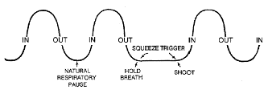
Breathing Control
Everybody needs to breath. When taking a shot, however, a shooter needs to be able to control their breathing cycle. Breathing while trying to aim and shoot will cause the weapon to move – and any slight movement of the rifle is magnified exponentially downrange.
If situation allows, the shooter should take final aim and squeeze the trigger during the natural pause between exhalation and inhalation. A shooter has approximately 8-10 seconds before discomfort and oxygen depravation causes his muscles to tremor, disrupting sight alignment.

Slide 39
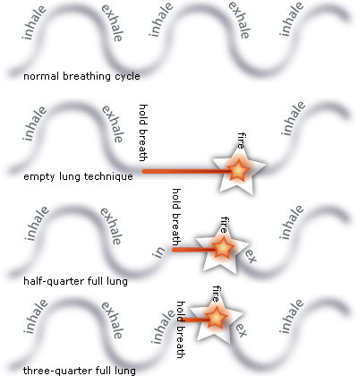
In optimum conditions, a shooter would preferably wait for the natural respiratory pause before taking a shot – however, in a real world combat situation a soldier must be able to pause his breath at any time to take a shot.
During an engagement where a soldier needs to fire more than one round at a target or there are multiple targets, a rapid and shallow controlled breathing cycle should be used. When the soldier is ready to make a shot they force a pause in their breathing cycle and squeeze the trigger.
When the shooter’s lungs are full they will be less stable then when they are exhaled and relaxed – as the stability of the position decreases, the wobble area of the sight picture increases. Thus, the shooter will have less time to take a shot when the lungs are more full.
Breathing Control – Real World

Slide 40
Trigger Control
Definition: Trigger control is the manipulation of the trigger, allowing the shot to break without disturbing sight alignment. Sight alignment and trigger control must be performed simultaneously in order to fire an accurate shot.
Squeezing the trigger is as much of a mental function as it is a motor skill one; the shooter must be able to concentrate on the sight alignment and resist the natural urge to flinch or buck as the trigger is smoothly squeezed without jerking or pulling it.
The M16 family of rifles has anywhere between a 7.5 to 10 pound trigger pull – the action of manipulating a 10 pound trigger on an eight pound rifle can be difficult task when trying to concentrate on keeping sight alignment on target.
Trigger control is one of the most important marksmanship fundamental; a shooter could have perfect body positioning, sight picture and alignment - but an improper trigger control could easily cause that seemingly perfect shot to miss. If the shooter exercises proper trigger control, the round will strike where the sights are aligned.

Slide 41
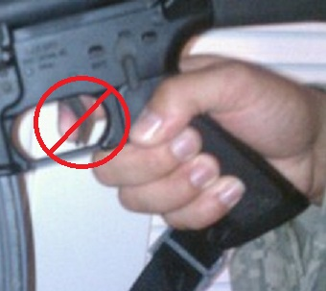
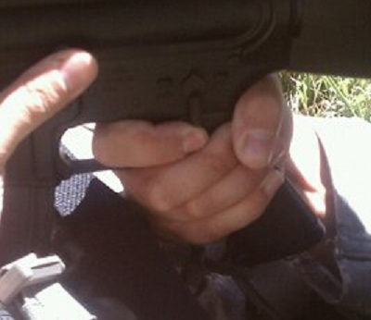
Trigger Control – Finger Placement
Many soldiers have been trained to use their finger tip to manipulate the trigger - this is quite literally pulling the trigger; the tip of the finger moves in an arc instead of directly to the rear, jerking the sights out of alignment and causing the bullet to miss the intended point of impact.
The shooter should instead put as much of his trigger finger as possible over the trigger, more or less making a fist over the trigger and pistol grip. Instead of pulling the trigger and the round, the shooter tightens his trigger finger - this will squeeze the trigger straight to the rear without disturbing sight alignment.

Slide 42
Trigger Control – Trigger Squeeze
Uninterrupted Trigger Squeeze
With uninterrupted trigger squeeze, the shooter applies the same SMOOTH pressure through the shot – there is no speeding up, slowing down or pauses in the trigger pressure. Because the shooter will be focused on the front sight post and sight alignment, the shot should come as a surprise to the shooter.
Interrupted Trigger Squeeze
If conditions are less than ideal and causing barrel wobble such as severe wind or shooting off-hand, the shooter may need to employ an interrupted trigger squeeze. Instead of following through completely on the trigger squeeze, the shooter pulls out some of the slack from the trigger. The shooter should not try and force the front sight post to the target – let the rifle sway naturally over the target. As the front sight post drifts toward the target the shooter should SMOOTHLY apply the remaining pressure to the trigger.

Slide 43
Trigger Control – Errors
Flinching – The shooter flinches from the anticipated recoil by moving his head, tensing of the arms, moving the shoulders rear, or blinking.
Bucking – The opposite of flinching – instead of pulling back from the recoil, the shooter anticipates it and tenses the shoulders forward to counter the recoil.
Jerking - Instead of manipulating the trigger mechanism straight to the rear, the shooter pulls the weapon out of alignment with poor trigger squeeze. This can be a result of quickly trying to get the round off before the front sight or reticule moves from the desired point of aim because of barrel wobble or wind. Jerking the trigger is a result of UN-SMOOTH trigger squeeze.
The shooter needs to be able to subconsciously move the trigger to the rear without thinking about it, concentrating on the sight alignment and point of aim instead of the recoil of the shot!

Slide 44
Trigger Control – Follow-Through
The shooter must continue to employ marksmanship fundamentals until the bullet exits the muzzle; even though the round is travelling at 3,100 feet per second, any undue movement on the shooter’s part can disrupt the shot. This is known as follow-through.
To ensure proper follow-through, the soldier should ensure the following occurs after each round is fired;
(1) Keeping the head infirm contact with the stock (stock weld).
(2) Keeping the finger on the trigger all the way to the rear.
(3) Continuing to look through the rear aperture or scope tube.
(4) Keeping muscles relaxed.
(5) Avoiding reaction to recoil and or noise.
(6) Releasing the trigger only after the recoil has stopped.
The soldier should release the trigger only to the point where the metallic click can be heard if another shot needs to be taken; this will eliminate the excess slack on the trigger. Because trigger pull on the M16A4/M4 can vary between six pounds per shot due to the burst function, eliminating the slack by holding the trigger after the metallic click is heard will allow for a much more consistent and smooth trigger squeeze.

Slide 45
Trigger Control – Calling Shots
As the shooter squeezes the trigger and follows-through with the shot he should be aware of where the front sight post or reticule was over the target. This is known as the final focus point.
Because iron sights offer no magnification, calling a shot and knowing where the final focus point is will give the shooter some idea of where the point of impact might be.
Getting in to the practice of calling the shot will also emphasize that the shooter concentrate on the front sight post during the trigger squeeze to locate the final focus point – this will help ensure that the sights stay aligned as the trigger is squeezed.
Notes:
A shooter can practice calling shots while dry firing as well, without worrying about poor trigger squeeze like flinching

Slide 46
Questions?

