Slide 1
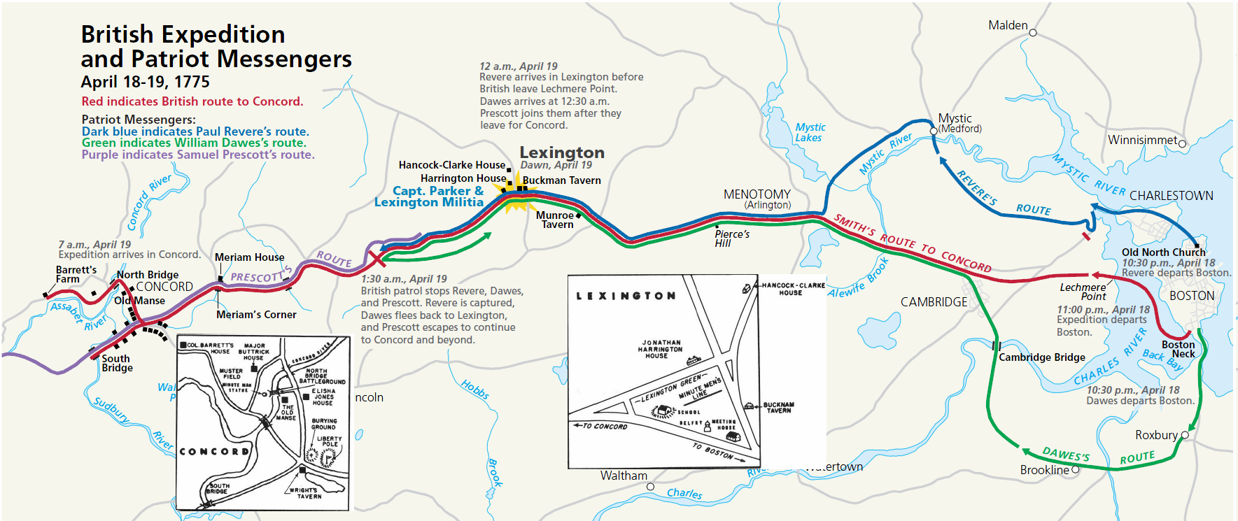
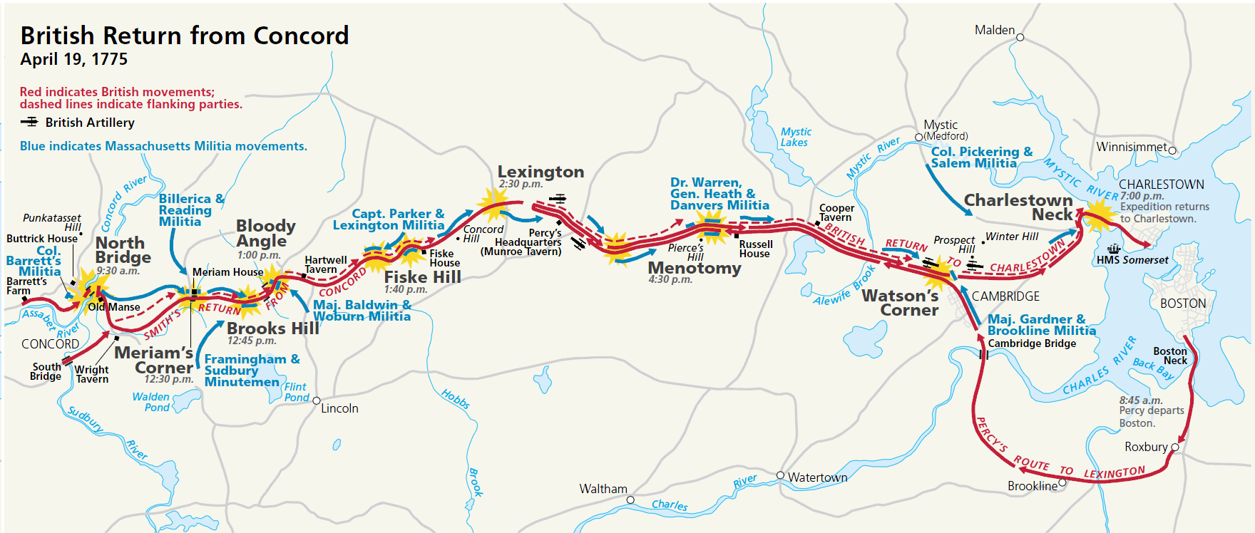
Appleseed History
Teaching Materials

Slide 2
Big Picture Timeline
1763
1764
1765
1766
1767
1768
1769
1770
1771
1772
1773
1774
1775
End of 7 Years’ War. Britain £140 million in debt. 4/5: Sugar Act imposes taxes on wide range of goods in America and subjects Americans to British Admiralty courts.
Protests and boycott over Sugar Act. Sam Adams calls for colonial congress, publishes statement of colonial rights.
Stamp Act passed by Parliament. Stamp Act Congress unites colonies in opposition. In August, Bostonians hang in effigy a Stamp agent.
Stamp Act repealed; not one stamp issued. Troops stationed in New York City. Townshend Acts passed in June, raising taxes on wide range of products and putting judges and governors on king’s payroll.
Townshend Acts: duties on wide range of goods, “writs-of-assistance” warrants, judges and governors paid directly by England. Boycott widened. Parliament dissolves New York assembly.
“True Sentiments of America” published. Colonies boycott all British goods. Adams initiates Circular Letter among colonies, endorsed by CT, NH, NJ, and VA. British begin military occupation of Boston. Troops “impress” Bostonians to serve in navy.
March 5: Boston Massacre. Sam Adams forces end of military occupation of Boston.
Adams creates Committees of Correspondence throughout colonies.
Tea Act imposes small tax on tea with discounted price as ploy to get Americans to accept Parliament’s authority to tax them. 12/16: Boston Tea Party
“Coercive Acts” passed. Gen. Gage made Governor of Massachusetts, determined to disarm Americans.
Congress passes Suffolk Resolves to ignore Coercive Acts, train militia, withhold taxes from royal government.
9/1: Gage’s Cambridge Powder Raid succeeds without opposition. 12/14: Portsmouth Powder Alarm foiled.
2/1: Salem Powder Alarm: foiled by townspeople’s delaying action at drawbridge.
4/19: Start of Revolutionary War
6/13: Battle of Bunker Hill – a draw. Siege of Boston begins
10/ : Americans take Ft. Ticonderoga, move cannon to Boston. 3/76 British leave Boston

Slide 3
April 19, 1775 Timeline
4/18
4/19
Daytime
9:00 pm
10:00
11: 00
12:00 am
1:00
2:00
3:00
4:00
5:00
6:00
7:00
8:00
9:00
10:00
11:00
12:00
1:00 pm
2:00
3:00
4:00
5:00
6:00
7:00
9:00am: Cannon and powder removed from Concord. Muskets buried at Barrett’s Farm.
Noon: British prepare the longboats. Dr. Warren gets report from Mrs. Gage detailing the entire British plan. Everyone in Boston soon knows everything.
Col. Smith’s force of 800 leaves Boston. Revere tells Newman to hang two lanterns in Christ Church. 10:15 Revere leaves for Charlestown. 11:00 Revere sets out on horseback.
Revere arrives at Lexington. British complete landing at Lechmere Point.
Smith’s force begins marching toward Concord.
4:30: American horsemen confront British on road. Pitcairn orders troops to load.
British troops arrive at Lexington. First shots. Eight Americans killed, nine wounded.
5:30: British leave Lexington
British arrive at Concord
Percy’s force of 1200 men leaves Boston to reinforce Smith.
Battle at the North Bridge. British break and run after two volleys.
Percy arrives in Lexington. Smith arrives about 2:30.
3:30: British leave Lexington. Fighting is continuous at every step. British kill civilians, loot and torch homes in Menotomy.
British arrive in Charlestown., where they are protected by Somerset’s cannon.

Slide 4
People to Remember
Americans
Before the Battle
Samuel Adams: “Father of the American Revolution”
Paul Revere
Robert Newman: sexton of Old North Church, set lanterns
William Dawes
Samuel Prescott: rode on to Concord after Revere captured
Dr. Joseph Warren: a leader in Sons of Liberty
Dr. Benjamin Church: traitor and spy for Gen. Gage
John Hancock
Margaret Kemble Gage: told Dr. Warren of British plan
Lexington
Capt. John Parker
Jonas Clarke
Jonathan Harrington
William Diamond (16): drummer
Jonathan Harrington (17): fifer
Joshua Simonds: ready to blow the powder, took 1st prisoner
Concord
Capt. Isaac Davis: Action minutemen leader, first officer KIA
Col. James Barrett: Concord militia leader
Maj. John Buttrick: Minutemen leader
Lt. Joseph Hosmer: “Will you let them burn the town down?”
Battle Road
Hezekiah Wyman: Death rides a pale horse.”
Sam Whittemore (80): Hero of the Commonwealth
David Lamson: Captured Percy’s supply wagons
Ruth Batherick: Captured 6 Grenadiers
Gen. William Heath: “Circle of Fire” tactic
British
Before the Battle
Thomas Gage
Col. Francis Smith
Maj. Edward Mitchell (captured Revere)
Lexington
Maj. John Pitcairn
Lt. Jesse Adair
Concord
Cpt. Walter Laurie: commander at North Bridge
Battle Road
Brig. General Lord Hugh Percy

Slide 5
What They Said…
Samuel Adams, 1748: “Loyalty is founded in the love and possession of liberty. It includes in it a thorough knowledge of our constitution, its conveniences and defects as well as its real advantages; a becoming jealousy of our immunities, and a steadfast resolution to maintain them.”
Charles Townshend, Chancellor of the Exchequer, 1766: “America should be deprived of its militating and contradictory charters, and its royal governors, judges and attorneys be rendered independent of the people.”
Samuel Adams, 1764: “For if our trade be taxed, why not our lands? Why not the produce of our lands and everything we possess or make use of?
Étienne François Choiseul, French minister of war, 1769: “The Americans will not lose out of view their rights and privileges; and, next to their fanaticism for religion, the fanaticism for liberty is the most daring in its measures and the most dangerous in its consequences.”
If men were angels, no government would be necessary. If angels were to govern men, neither external nor internal controls on government would be necessary. (James Madison)
"Young man, what we meant in going for those Redcoats was this: we always had governed ourselves and we always meant to. They didn't mean we should."
(Captain Levi Preston, of the Danvers militia, at age 91, remembering the day)
That it is an indispensable duty which we owe to God, our country, ourselves and posterity, by all lawful ways and means in our power to maintain, defend and preserve those civil and religious rights and liberties, for which many of our fathers fought, bled and died, and to hand them down entire to future generations. Suffolk Resolves, September 9, 1774, attributed to Dr. Joseph Warren

Slide 6
50 Years After the Founding
Alexis de Tocqueville was a French political philosopher who traveled throughout the United States in the 1830. His most famous book, Democracy in America, was published in 1835.
Tocqueville, in Democracy in America, remarked that while the Americans of the 1830s were not cultured or artistic minded as Europeans, nearly everyone was literate, knowledgeable and active in matters of politics and public affairs. Later in the book he warned us what could happen if we lost that happy aspect of our national personality:
"I seek to trace the novel features under which despotism may appear in the world. The first thing that strikes the observation is an innumerable multitude of men, all equal and alike, incessantly endeavoring to procure the petty and paltry pleasures with which they glut their lives. Each of them, living apart, is as a stranger to the fate of all the rest; his children and his private friends constitute to him the whole of mankind. As for the rest of his fellow citizens, he is close to them, but he does not see them; he touches them, but he does not feel them; he exists only in himself and for himself alone; and if his kindred still remain to him, he may be said at any rate to have lost his country...
“Above this race of men stands an immense and tutelary power, which takes upon itself alone to secure their gratifications and to watch over their fate. That power is absolute, minute, regular, provident, and mild. It would be like the authority of a parent, if, like that authority, its object was to prepare men for manhood; but it seeks, on the contrary, to keep them in perpetual childhood; it is well content that the people should rejoice, provided they think of nothing but rejoicing. For their happiness such a government labors; but it chooses to be the sole agent and the only arbiter of that happiness; it provides for their security, foresees and supplies their necessities, facilitates their pleasures, manages their principal concerns, directs their industry, regulates the descent of property, and subdivides their inheritances; what remains, but to spare them all the care of thinking and all the trouble of living? Thus it every day renders the exercise of the free agency of man less useful and less frequent; it circumscribes the will within a narrower range and gradually robs a man of all the uses of himself. The principle of equality has prepared men for these things; it has predisposed men to endure them and often to look on them as benefits...
“They devise a sole, tutelary, and all-powerful form of government, but elected by the people. They combine the principle of centralization and that of popular sovereignty; this gives [men] a respite; they console themselves for being in tutelage by the reflection that they have chosen their own guardians...By this system the people shake off their state of dependence just long enough to select their master and then relapse into it again...
“Subjection in minor affairs breaks out every day and is felt by the whole community indiscriminately. It does not drive men to resistance, but it crosses them at every turn, till they are led to surrender the exercise of their own will. Thus their spirit is gradually broken and their character enervated...It is in vain to summon a people who have been rendered so dependent on the central power to choose from time to time the representatives of that power; this rare and brief exercise of their free choice, however important it may be, will not prevent them from gradually losing the faculties of thinking, feeling, and acting for themselves, and thus gradually falling below the level of humanity."
Tocqueville wrote that in the 1830s, and where are we now? Apathy and ignorance are our greatest enemies. If we in Appleseed can restore that active, vigilant citizen, we will have done our descendants the greatest possible service.

Slide 7
Being an Active Citizen
April 19 was a victory because of the strong community bonds among the Americans, which enabled them to organize within their towns and communicate between towns. Without internet or cell phones, they mobilized 14,000 men in one day to defend their liberty. How many people can you mobilize to participate in the government they gave us?

Slide 8
Bibliography
Paul Revere’s Ride
Samuel Adams – Father of the American Revolution

